Slide 1


EcoCart+
Eco-Friendly E-commerce Portal with Role-Based Sustainability Evaluation
by
MyclineShareena John Peter Kennedy

Slide 2




Current E-commerce Challenges
Sustainability Oversight
Transparency Gap
Missing Accountability
Buyers lack product environmental information
No platform holds sellers responsible
Platforms ignore environmental impact

Slide 3
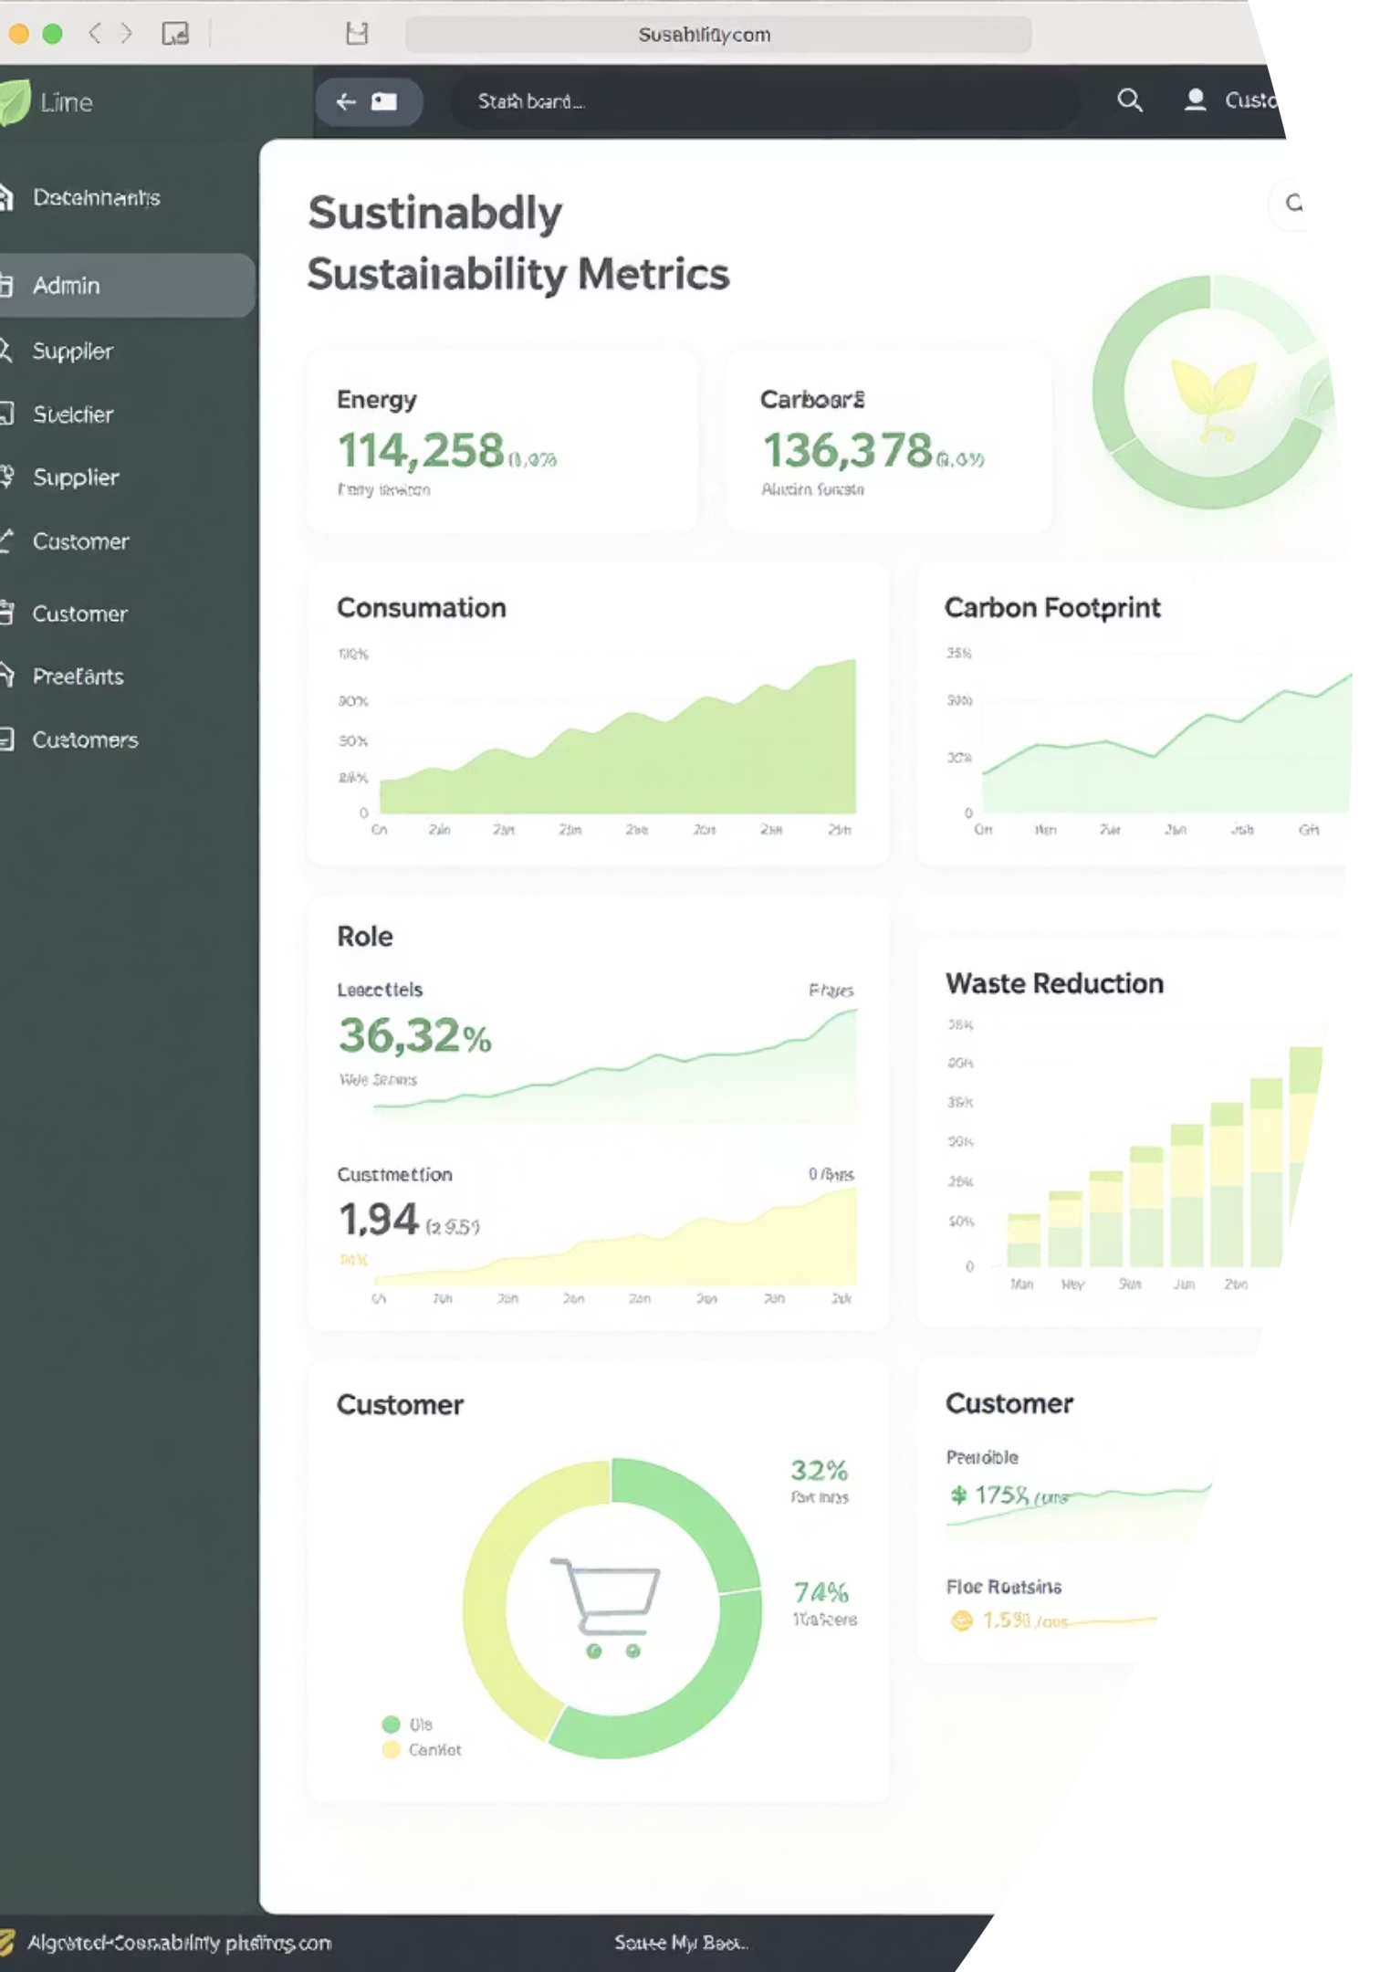



Our Solution: EcoCart+
Eco-Score Certification
Carbon Tracking
Verified ratings by external auditors
Real-time delivery emissions calculation
Role-Specific Dashboards
Specialized workspaces for stakeholders

Slide 4




System Architecture Overview
Network
1
EcoCart+
4 Enterprises
2
Seller, Shipping, Eco-Certification, Customer Support
6 Organizations
3
Product, Order Management, Shipping, Financial, Eco Auditing, Customer Support
8+ Unique Roles
4
Admin, Seller, Buyer, Product Auditor, Eco Auditor, Shipping Coordinator, Shipping Accountant, Seller Accountant, Customer Support -

Slide 5
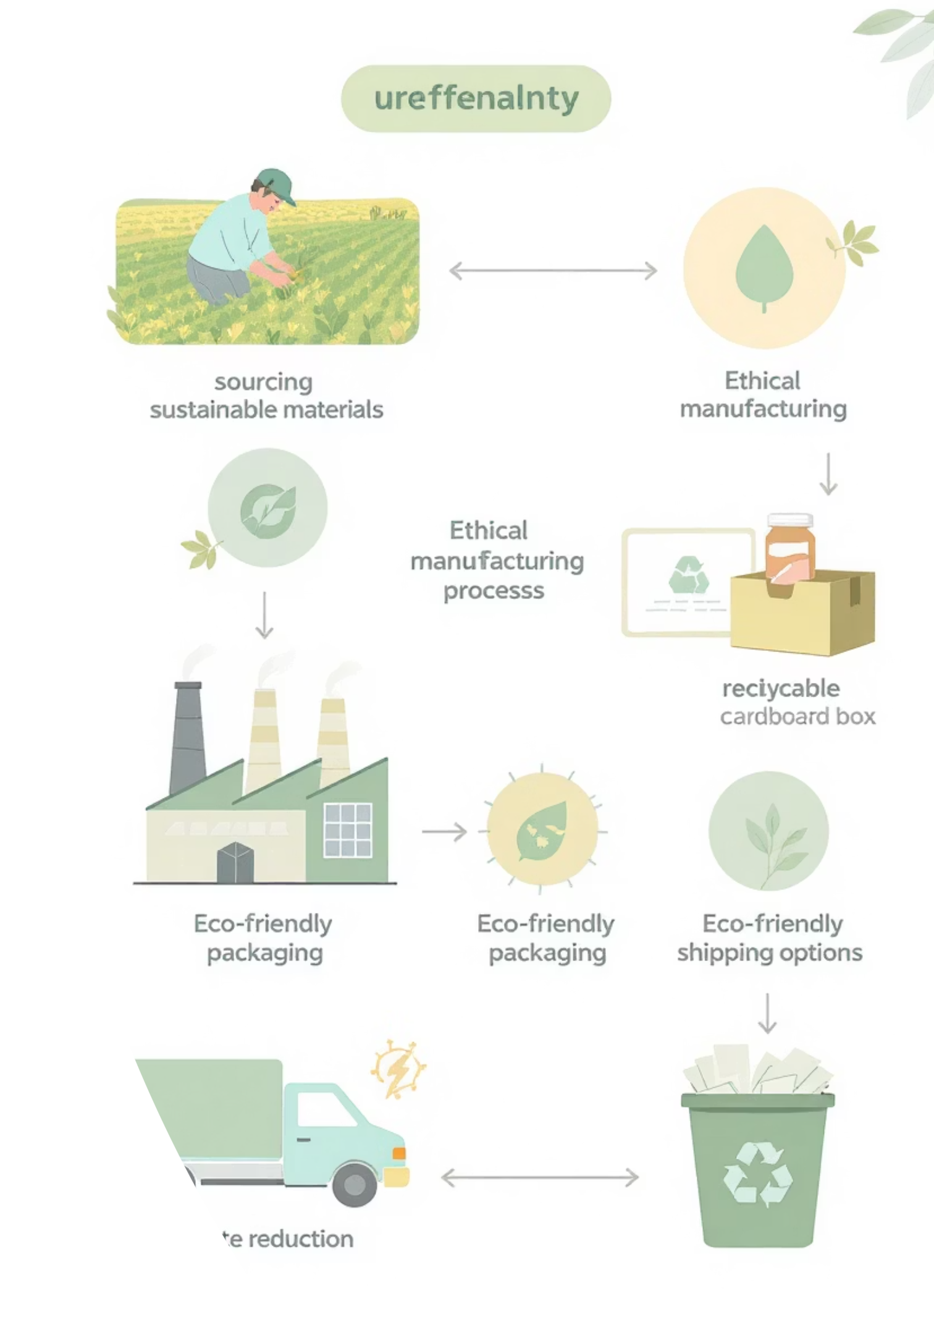



Core Use Cases & Workflows
Product Certification
ProductCertification Request
Order Fulfillment
Order Fulfillment Request
Carbon Tracking Request
Payment Processing Request
Cross-Organization Requests
Sustainability Audit Request
Support Escalation Request
Financial Settlement Request
Product Approval Request

Slide 6
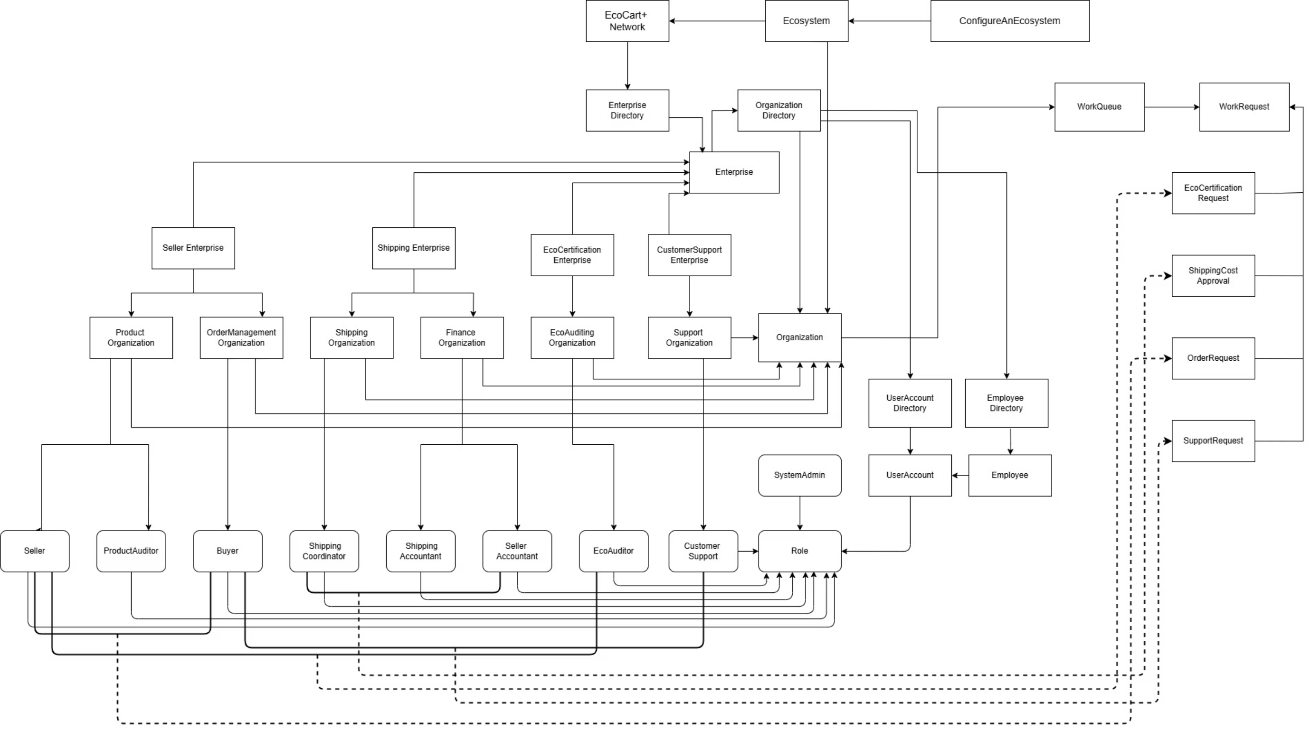
High Level Diagram

Slide 7
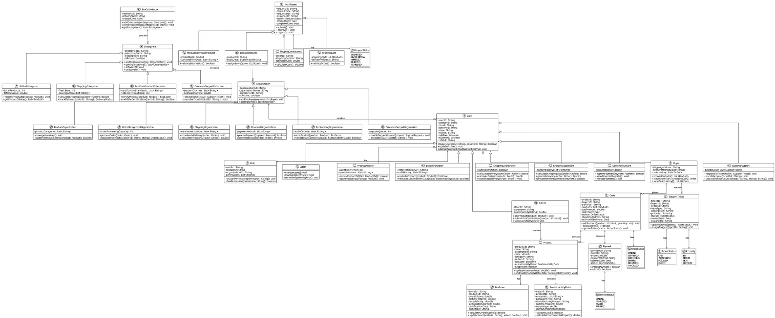
UML Diagram

Slide 8
Advanced Features & Innovation
Technical Excellence
Sustainability Features
MongoDB integration
Carbon footprint calculator
Role-based authentication
Multi-criteria assessment
Real-time updates
Transparency dashboard

Slide 9








System Impact & Value
Environmental
Business
Carbon transparency
Sustainability as advantage
Logistics
Stakeholders
Eco-friendly delivery networks
Informed purchasing decisions

Slide 10
Project Achievements & Future
Requirements Fulfilled
Future Enhancements
4 Enterprises
AI recommendations
6 Organizations
Mobile application
8+ Unique Roles
Carbon offset features
4+ Work Requests

